Slide 1

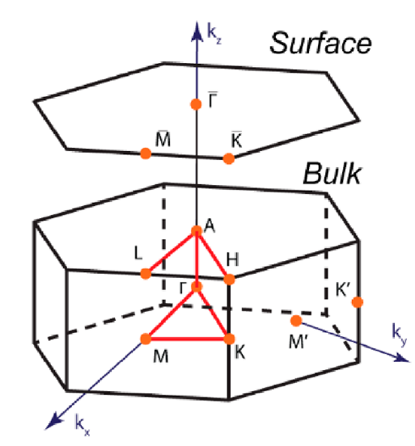

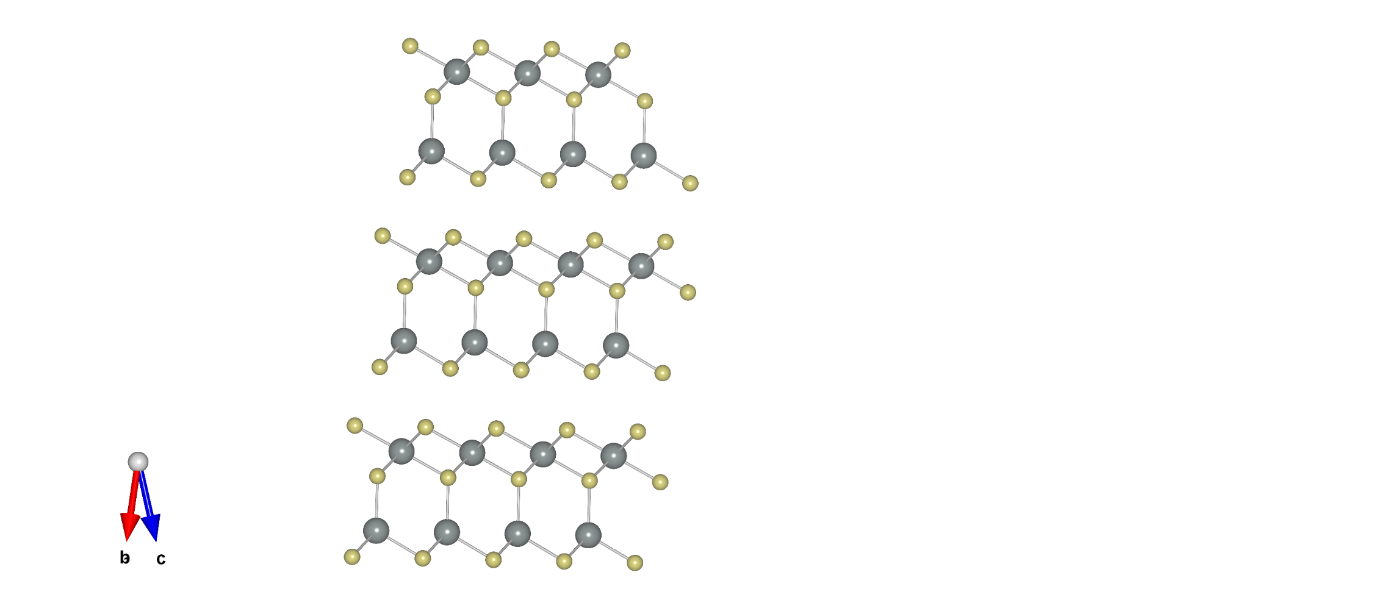

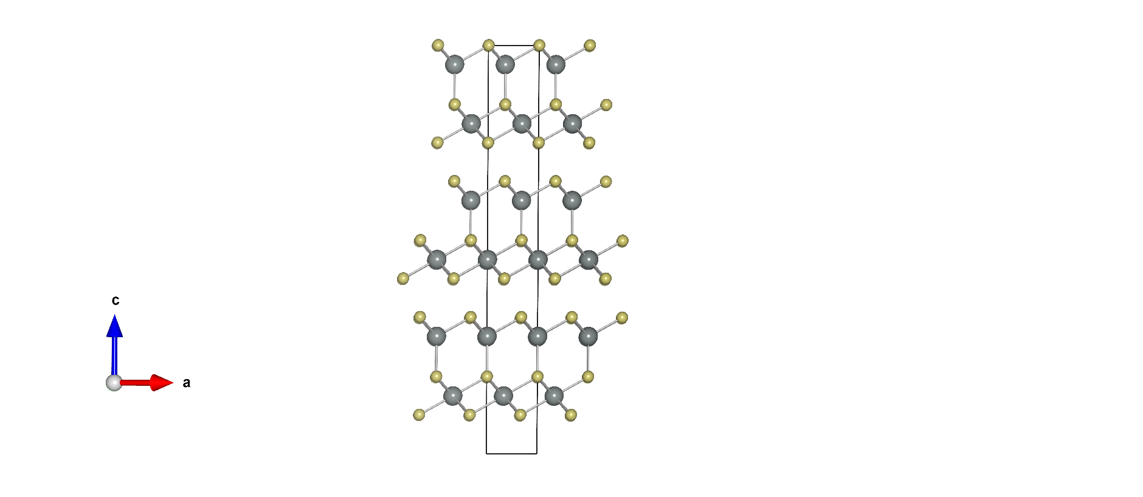
In₂Se₃ α phase: Fundamental Properties of the Quintuple Layer monolayer
Rhombohedral (3R)
Hexagonal (2H)
In
Space group R3m
Space group P6₃/mmc
Se
C
A
c = 28,750 Å from XRD
B
B
c = 19,217 Å from XRD
A
A

Slide 2
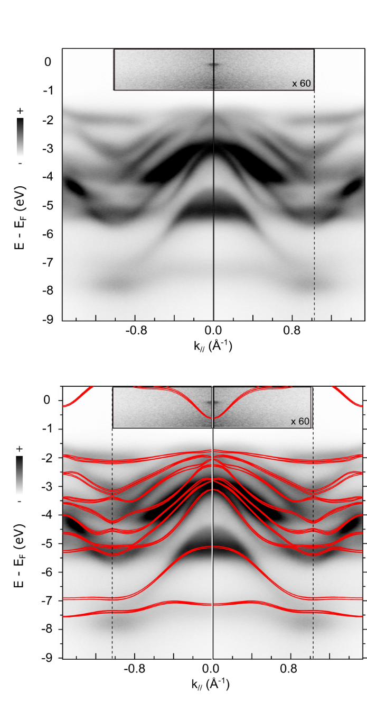
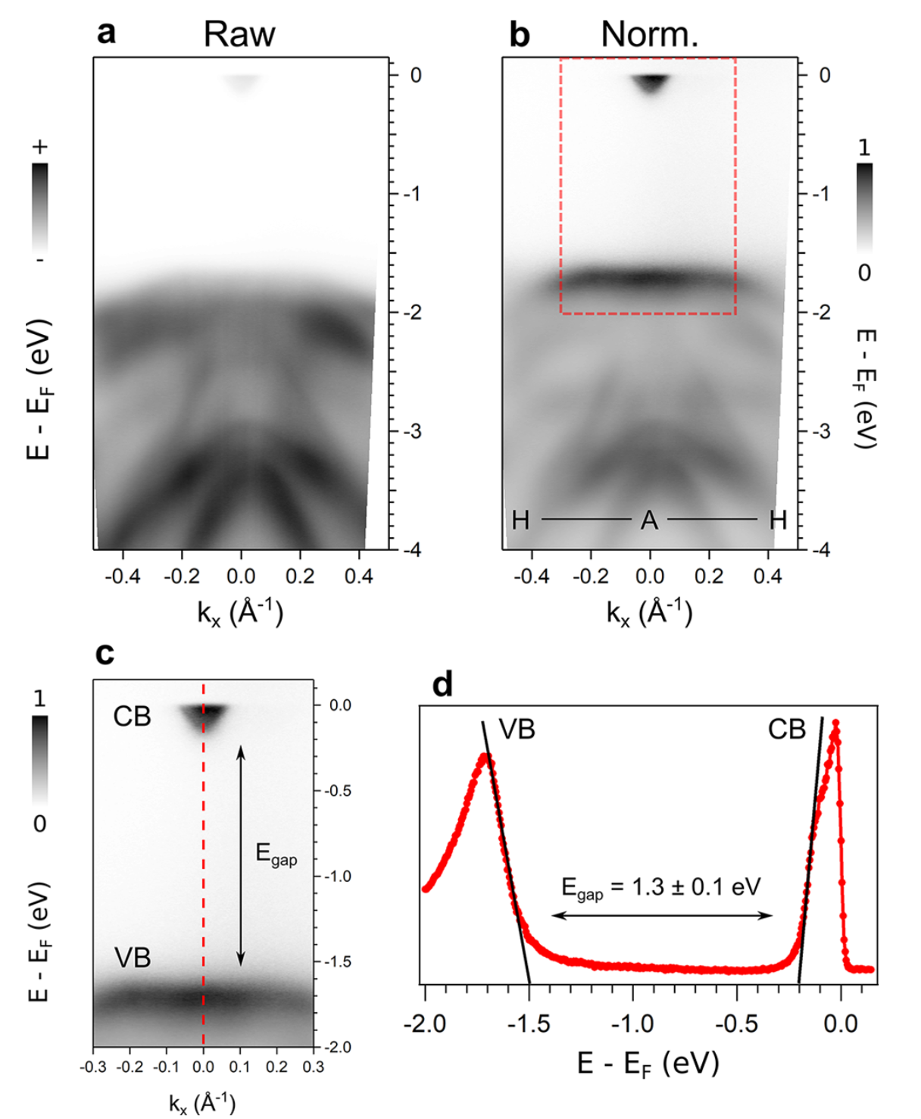
In₂Se₃ α phase: ARPES : conduction band
ACS Nano 2023, 17, 19, 18924–18931 (2023)

Slide 3
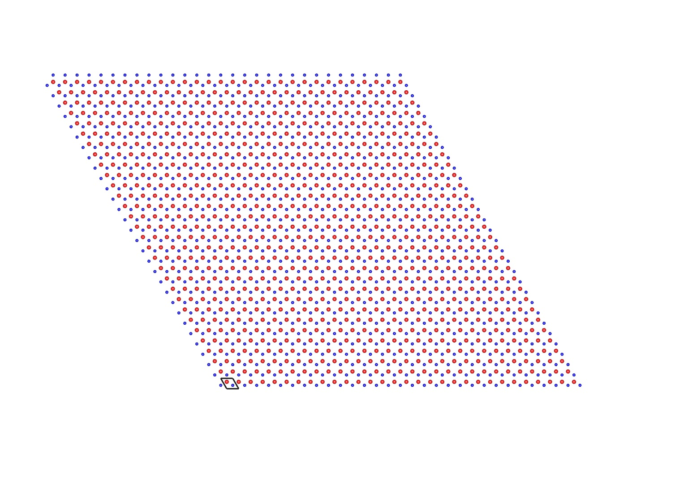
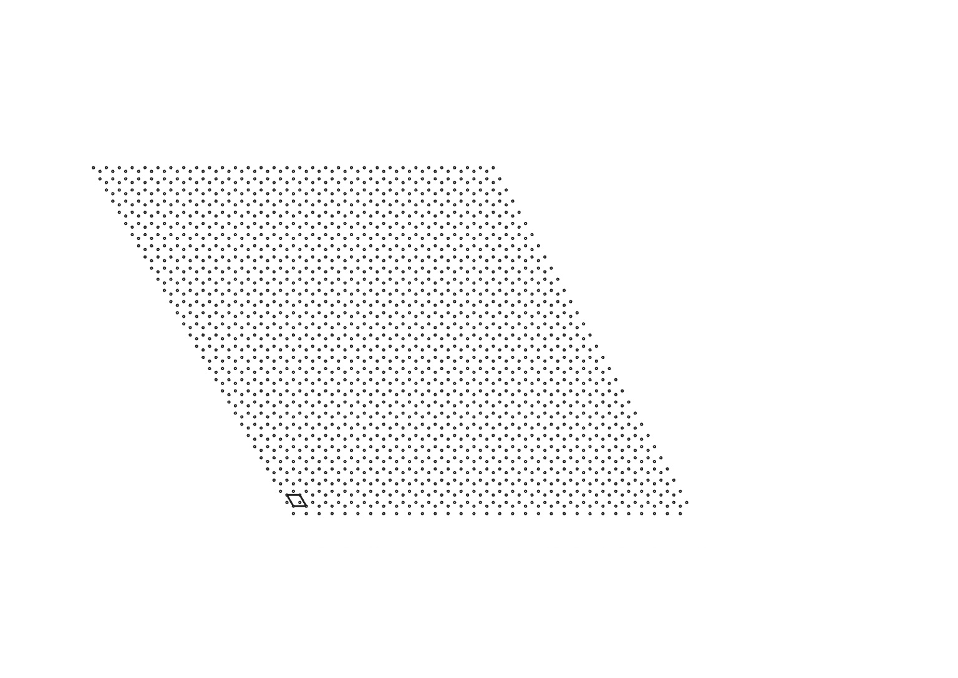
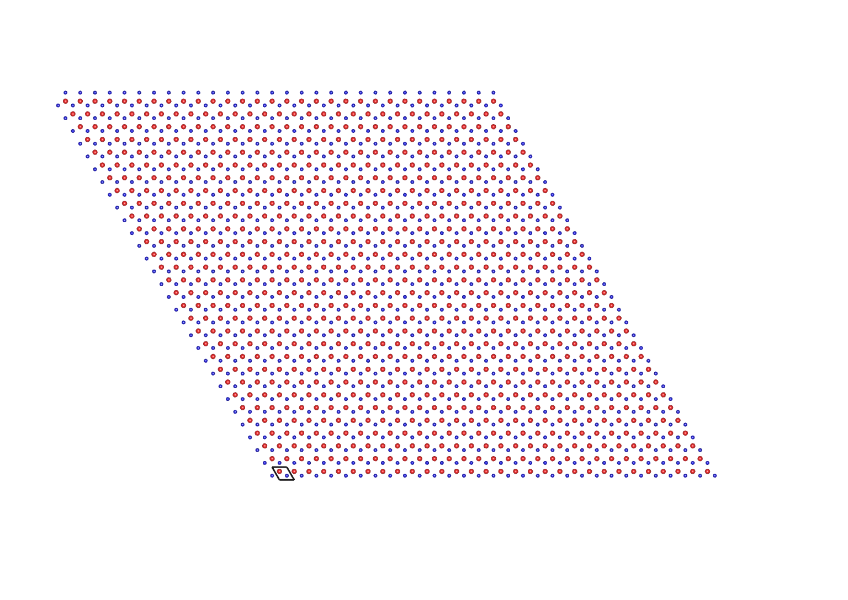
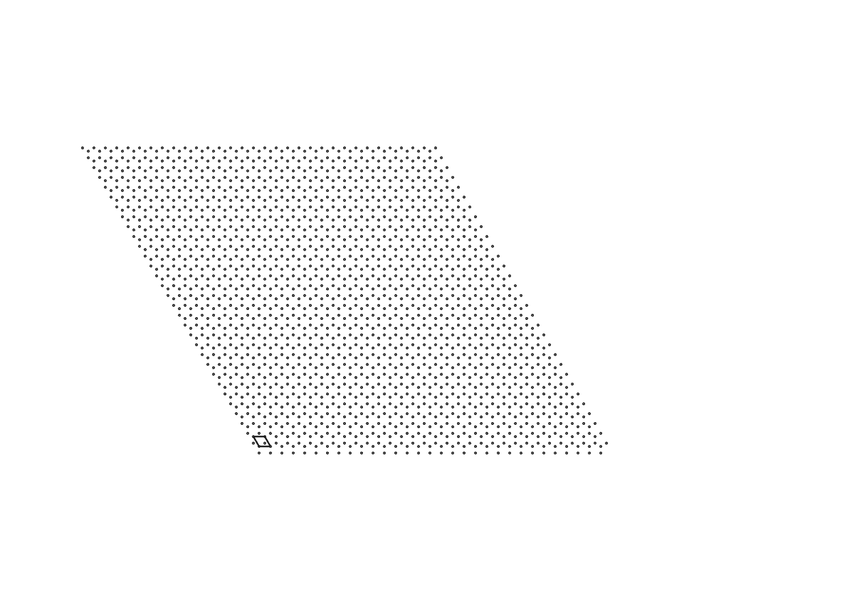
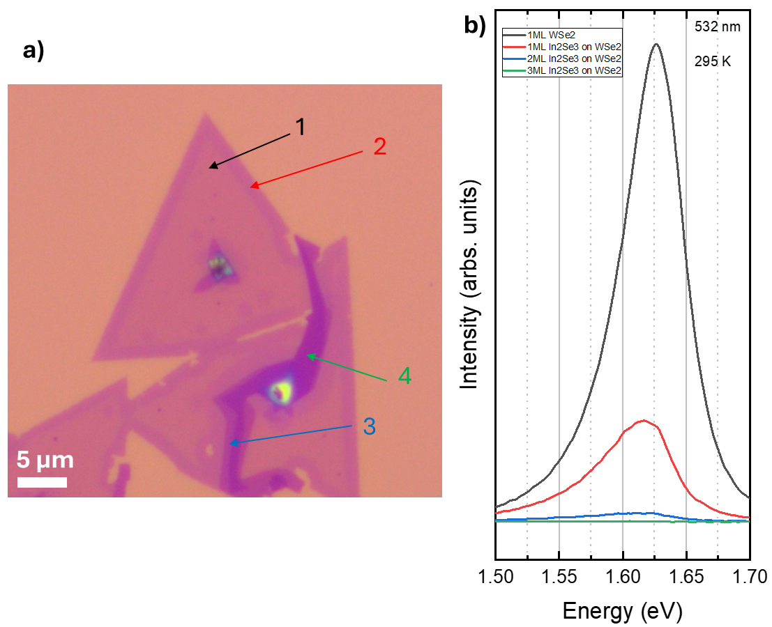
In₂Se₃ on WSe₂ heterostructure
1
2

Slide 4
In₂Se₃ on WSe₂ heterostructure
1
2
A1(LO + TO)
A1(LO)

Slide 5
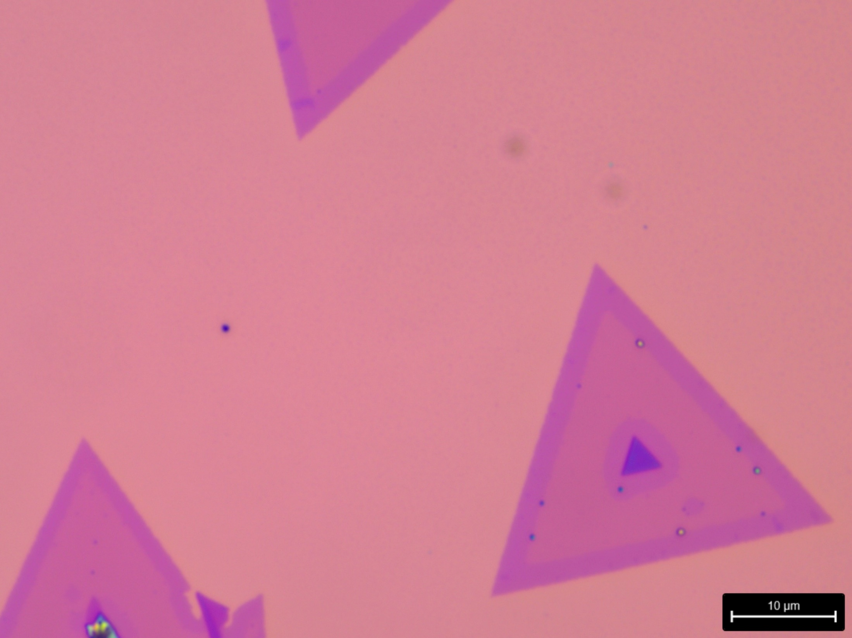
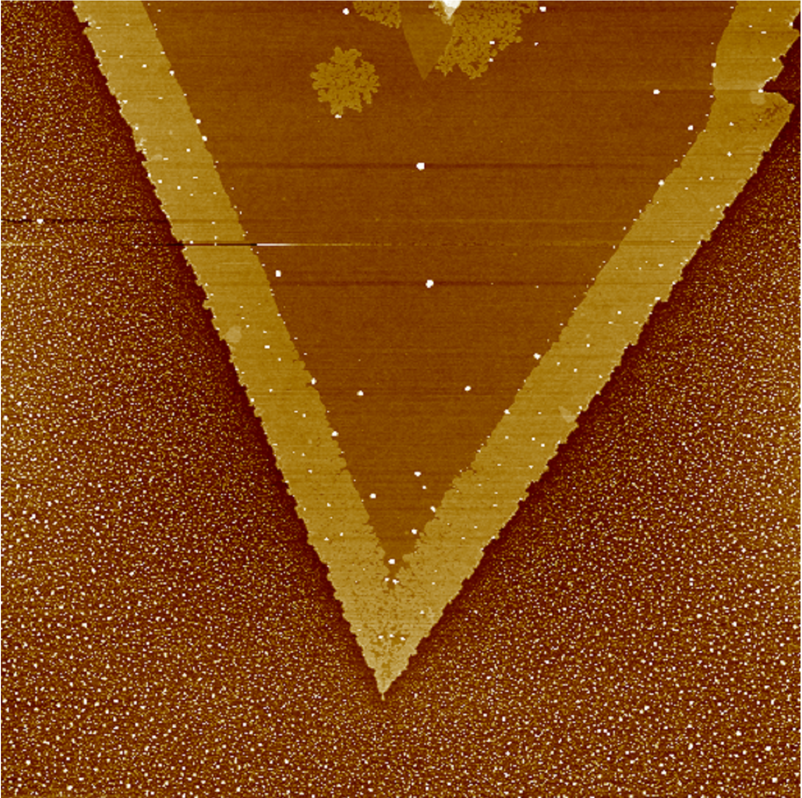
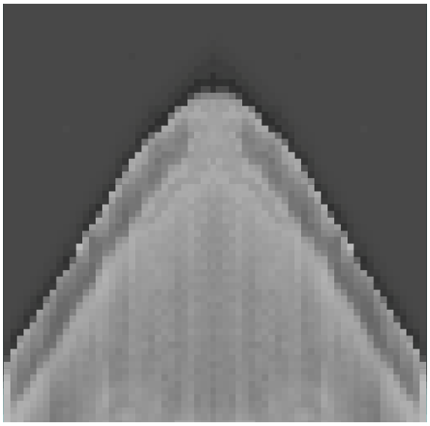
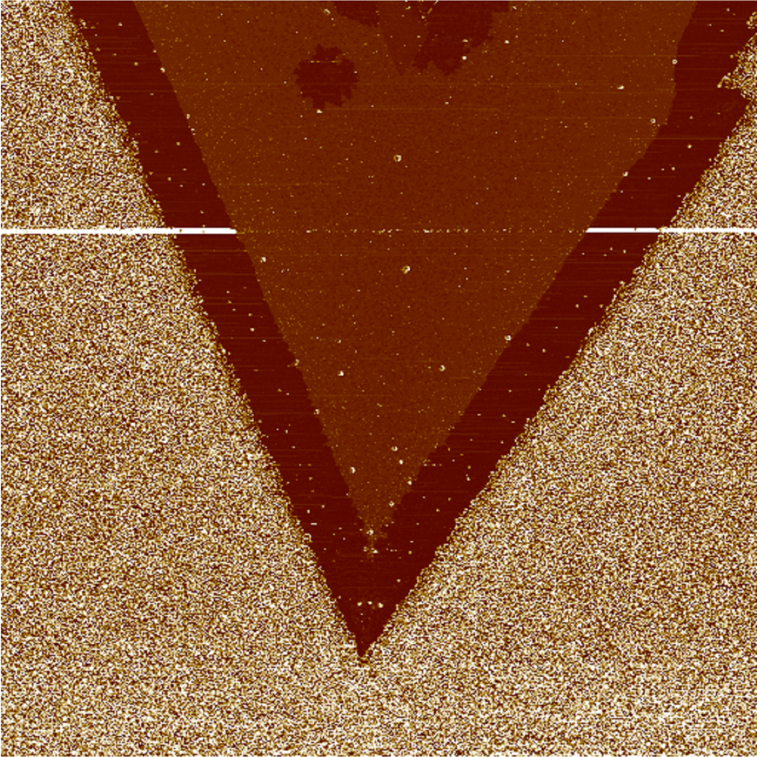
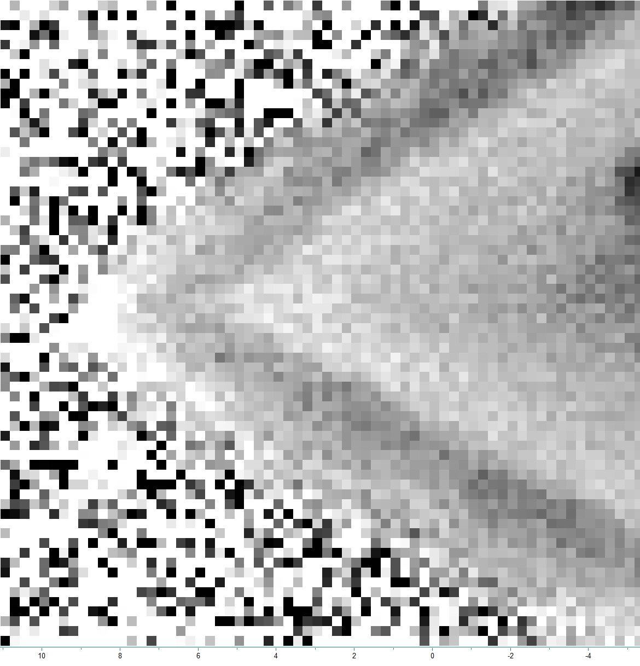
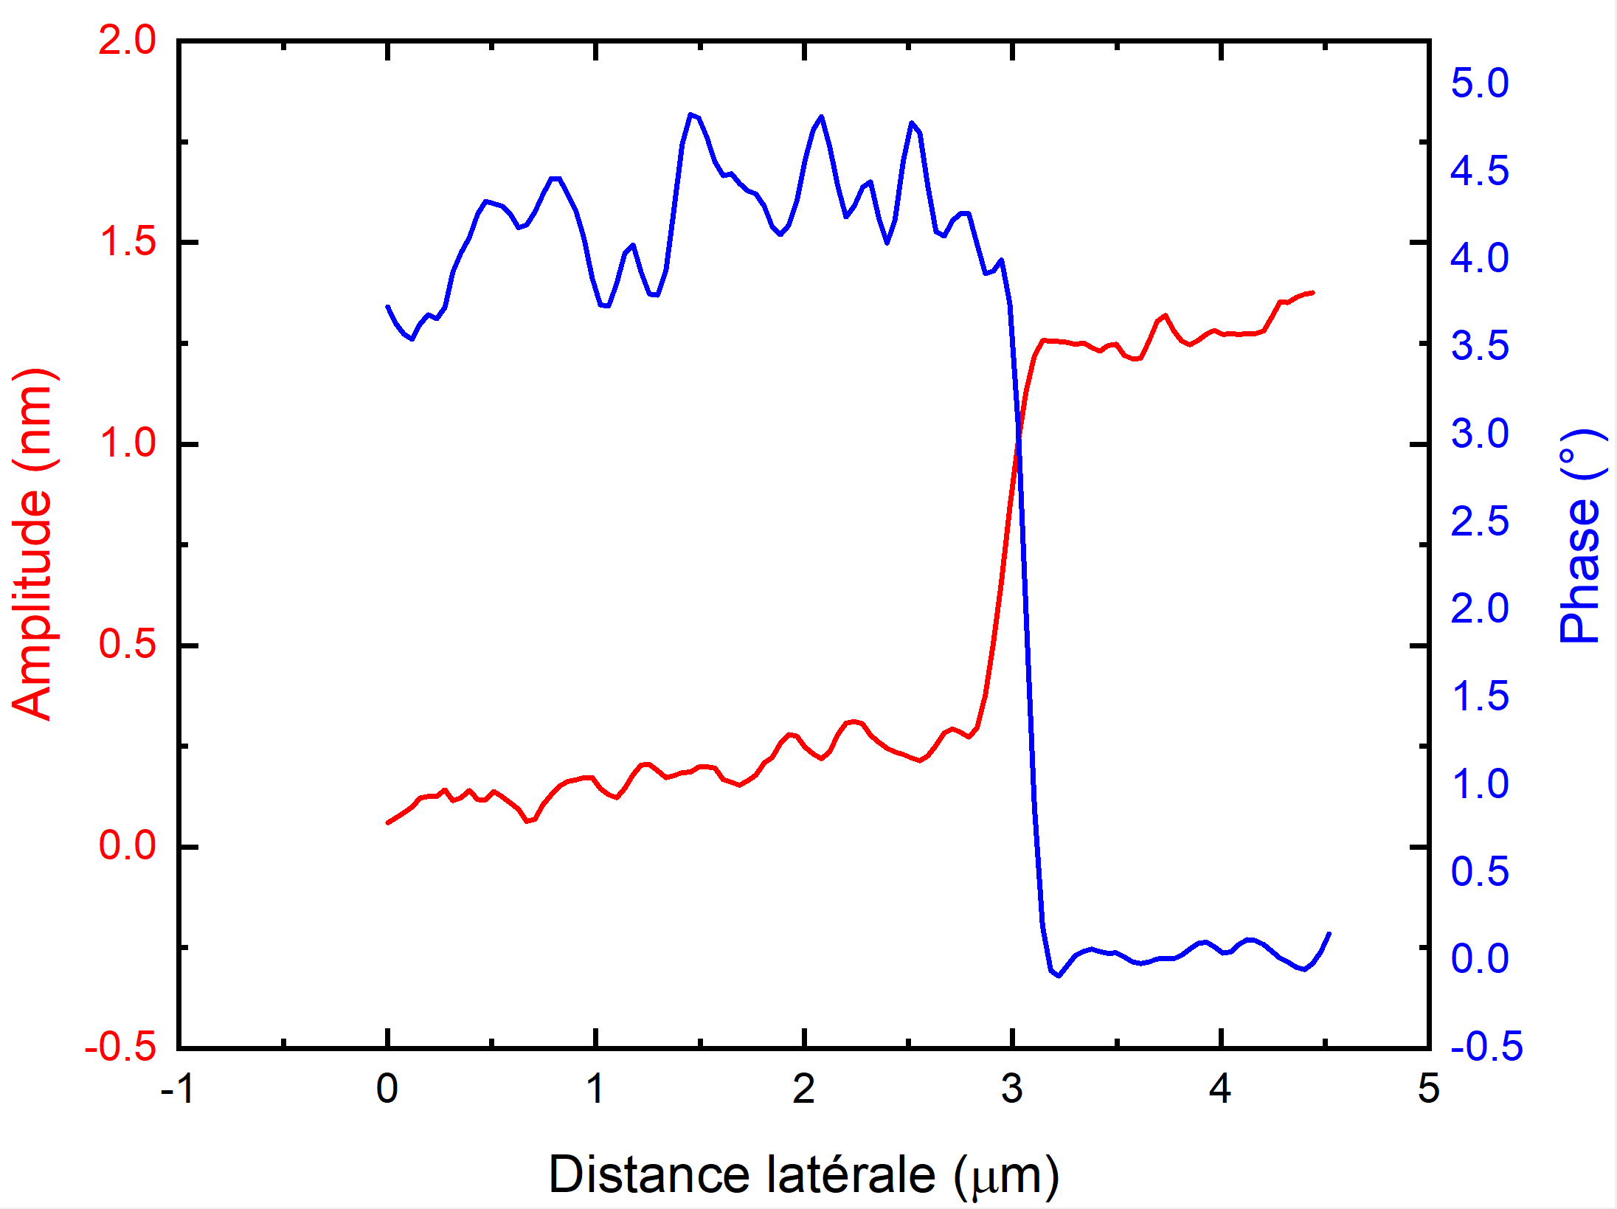
In₂Se₃ on WSe₂ heterostructure
a)
10 µm
c)
2 µm
e)
1
2
b)
d)
f)

Slide 6
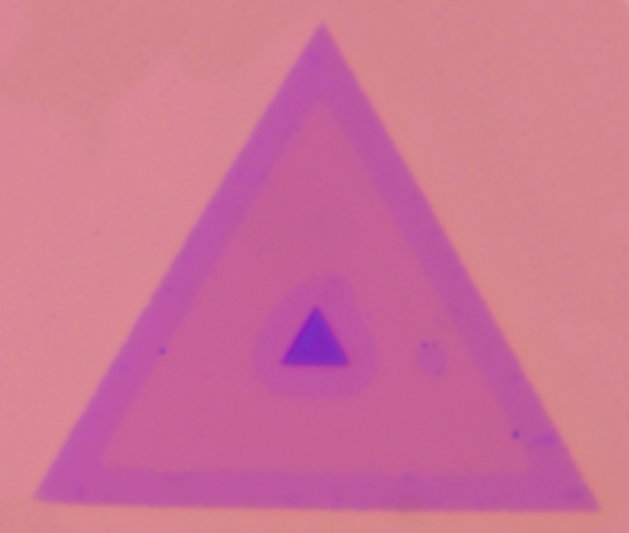
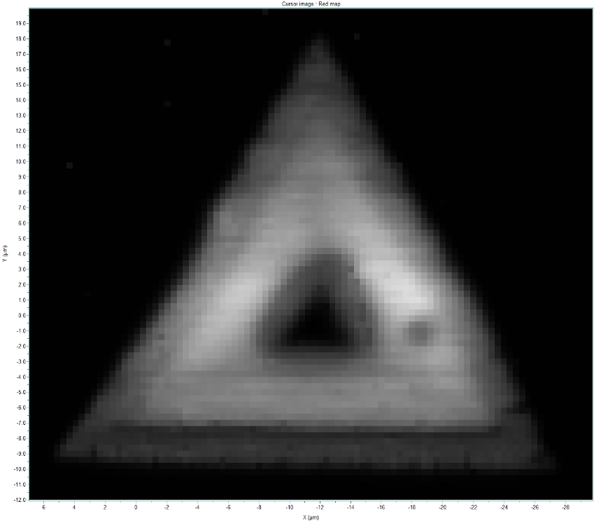
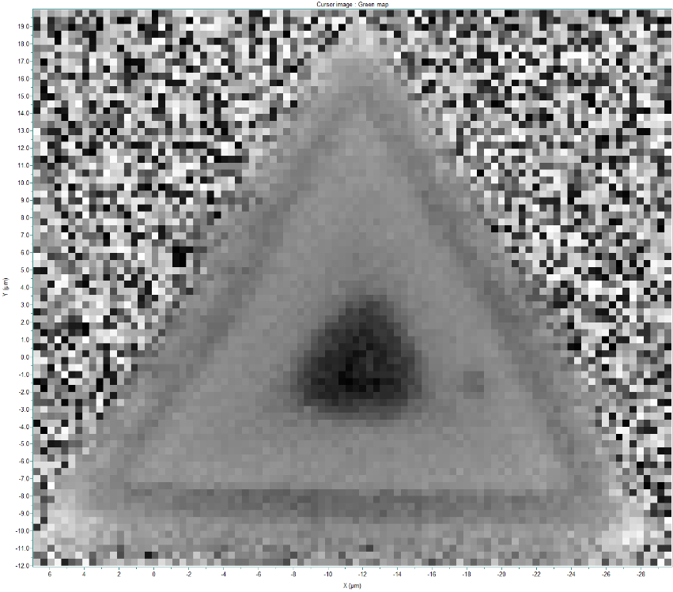
In₂Se₃ on WSe₂ heterostructure
1
2
a)
10 µm
b)
c)

Slide 7
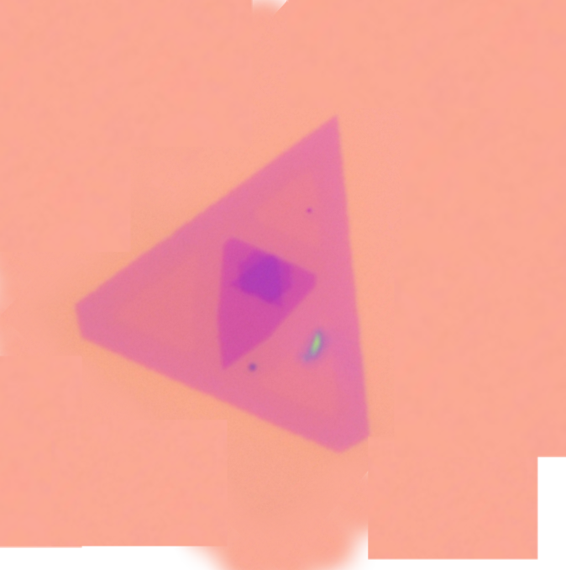
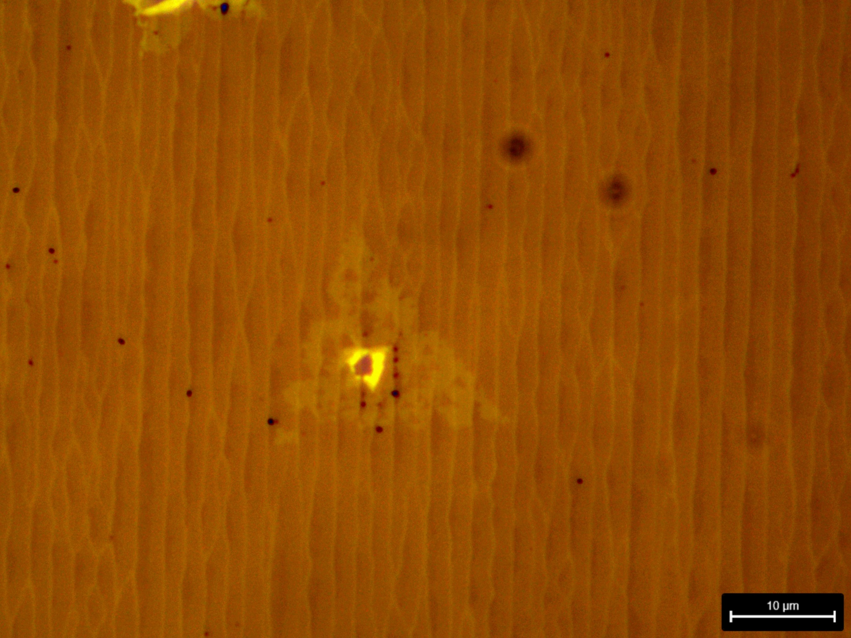
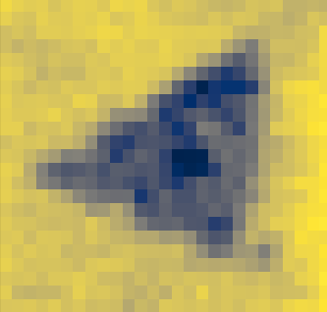
In₂Se₃ on WSe₂ heterostructure
a)
b)
c)
1
2
Integration In
10 µm

Slide 8
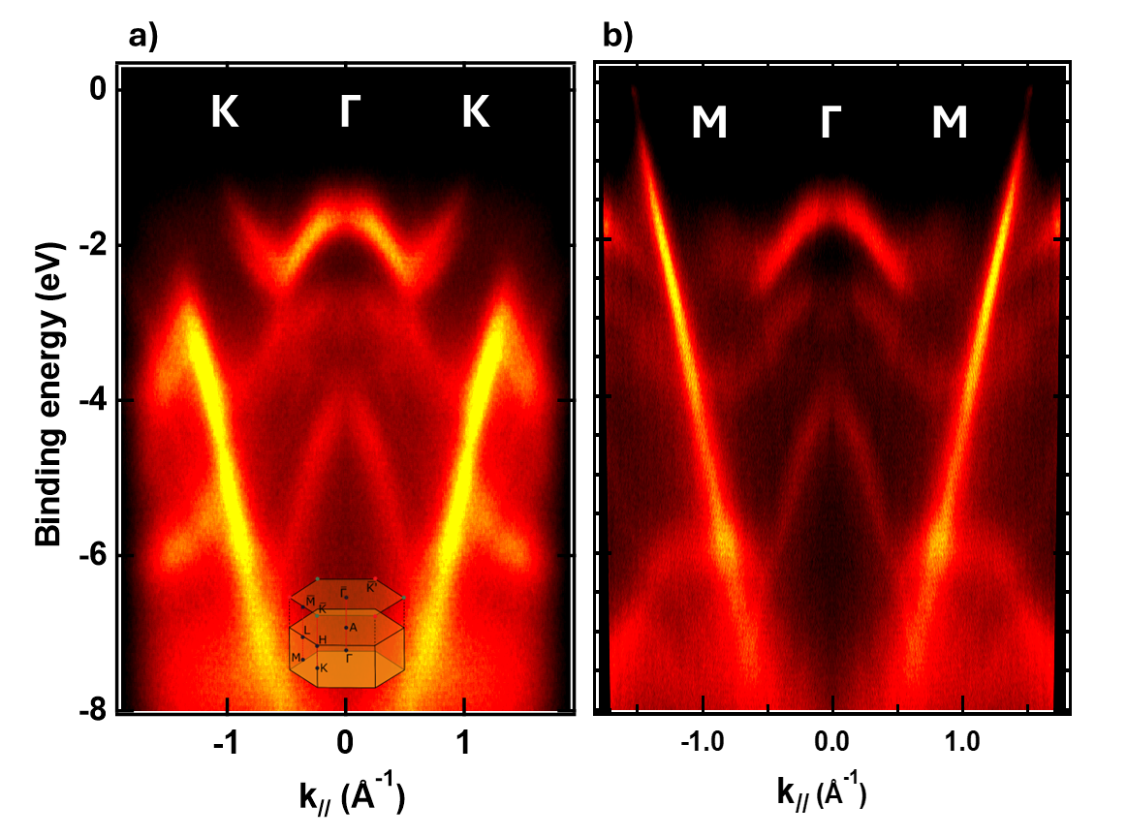
In₂Se₃ on WSe₂ heterostructure
1
2

Slide 9
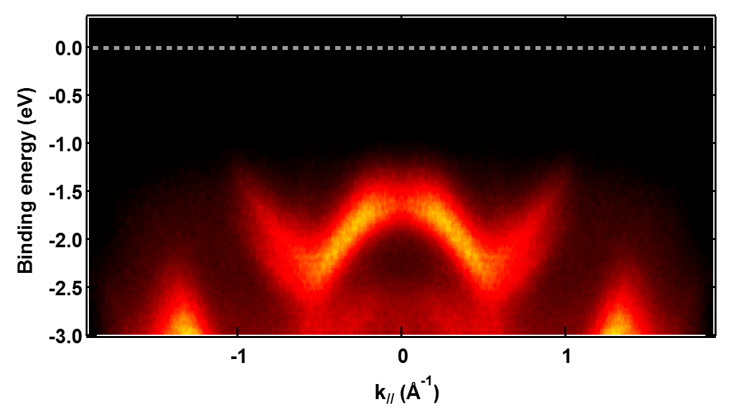
In₂Se₃ on WSe₂ heterostructure
a)
b)
ΔE
Δk
c)
d)
ΔE_{R} = 0,235 ± 0,01 eV
Δk_{R} = 0,245 ± 0,01 Å⁻¹
α_{R} = 1,9 ± 0,2 eV Å

Slide 10
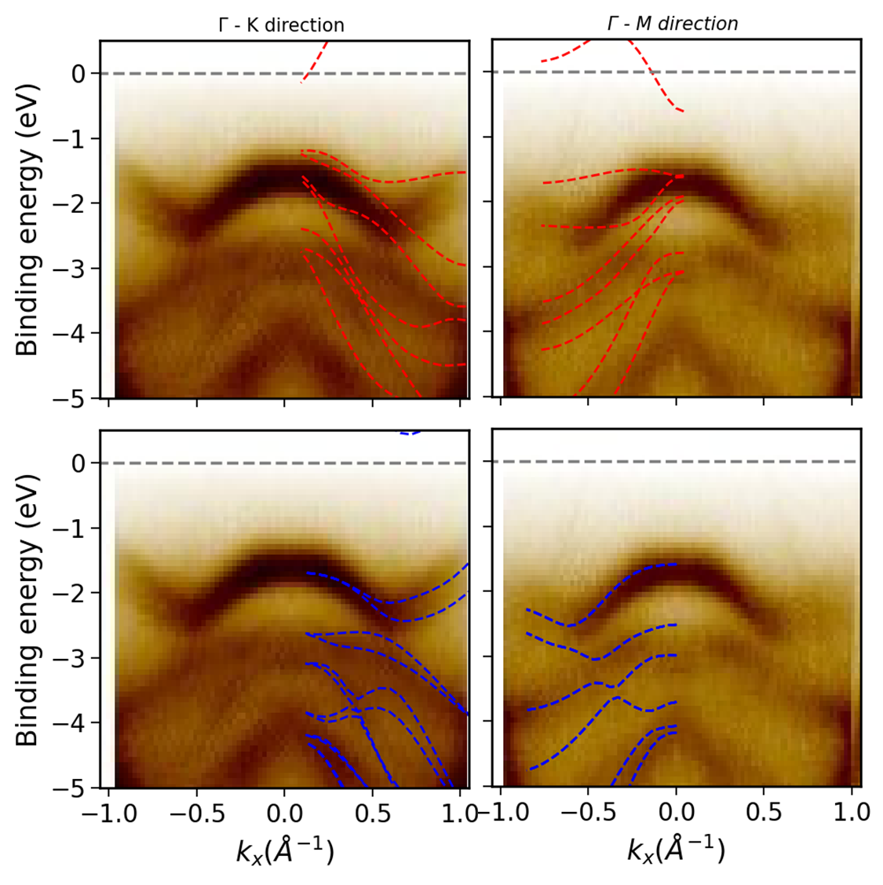
In₂Se₃ on WSe₂ heterostructure
1
2

